Slide 1
Software Engineering Practice Week 5

Slide 2
Project Plan –Tutoring 3
week | Iteration | Start Date | End Date | Release
Week 4 | Iteration 0 | 13/08/2018 | 19/08/2018 | 1
Week 5 | Iteration 1 | 20/08/2018 | 27/08/2018 | 1
Week 6 | Iteration 2 | 27/08/2018 | 2/09/2018 | 1
Week 7 | Iteration 3 | 3/09/2018 | 9/09/2018 | 1
week | Iteration | Start Date | End Date | Release
Week 8 | Iteration 1 | 10/09/2018 | 16/09/2018 | 2
Week 9 | Iteration 2 | 17/09/2018 | 23/09/2018 | 2
Week 10 | Iteration 3 | 24/09/2018 | 2/10/2018 | 2
Week 11 | Iteration 4 | 3/10/2018 | 9/10/2018 | 2
Week 12 | Iteration 5 | 10/10/2018 | 17/10/2018 | 2
Assignment 1
Show Case
Assignment 2
Show Case

Slide 3
Java Development Track

Slide 4

CRUD
REST
Maven
AOP
Spring
Spring MVC
Heroku
Jenkins
HATEOAS
Spring Security
Spring Boot
Junit
Thymeleaf.
Eclipse
Welcome to the Desert of the Real

Slide 5
Terminology
What is CRUD
What is REST
What is Maven
What is AOP
What is Spring
What is Spring Boot and thymeleaf.
Now… We can Start Coding ☺!

Slide 6
What is CRUD?
“In computer programming, create, read, update and delete (as an acronym CRUD) (Sometimes called SCRUD with an "S" for Search) are the four basic functions of persistent storage.”
http://en.wikipedia.org/wiki/Create,_read,_update_and_delete

Slide 7
What is REST?
“Representational state transfer (REST) is an abstraction of the architecture of the World Wide Web; more precisely, REST is an architectural style consisting of a coordinated set of architectural constraints applied to components, connectors, and data elements, within a distributed hypermedia system.”
http://en.wikipedia.org/wiki/REST

Slide 8
Basic CRUD with REST
Operation | HTTP / REST
Create | PUT / POST
Read (Retrieve) | GET
Update (Modify) | PUT / PATCH
Delete (Destroy) | DELETE

Slide 9


Slide 10
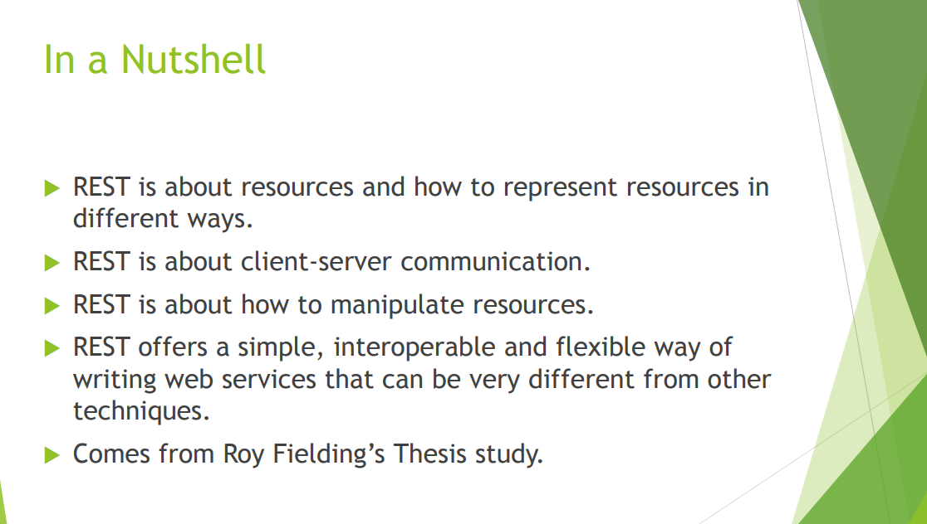

Slide 11
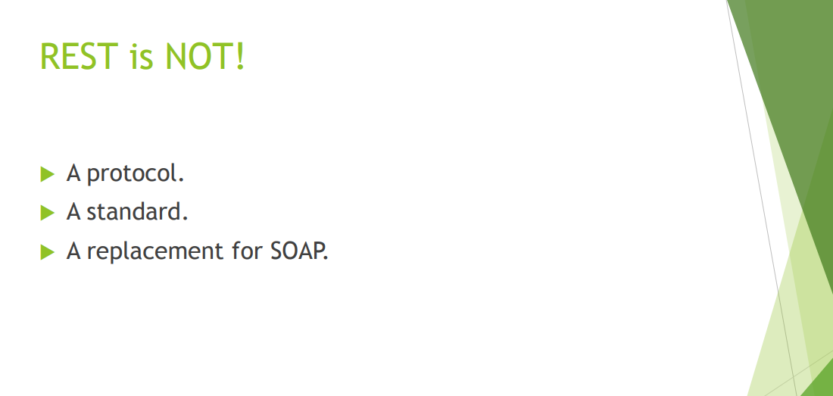

Slide 12
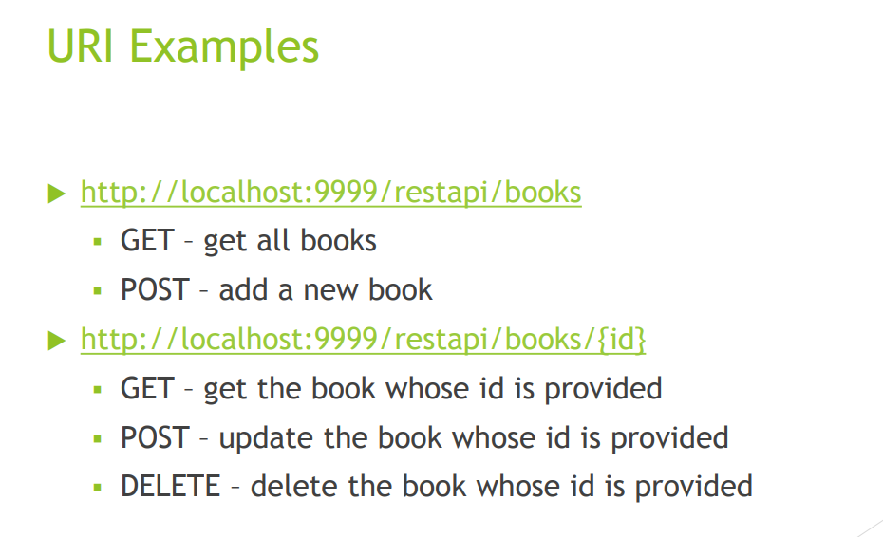

Slide 13
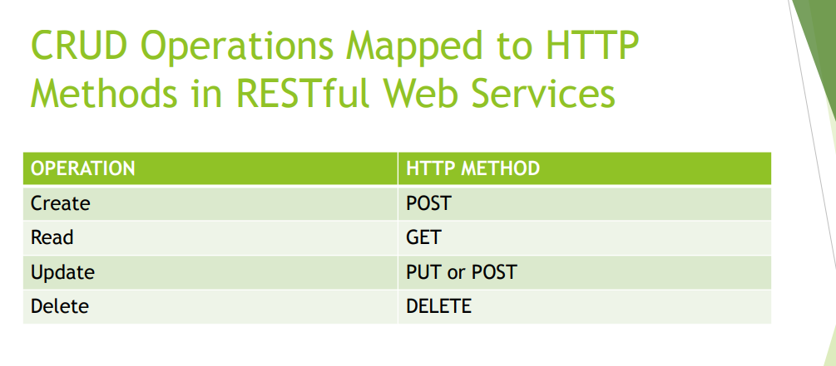

Slide 14
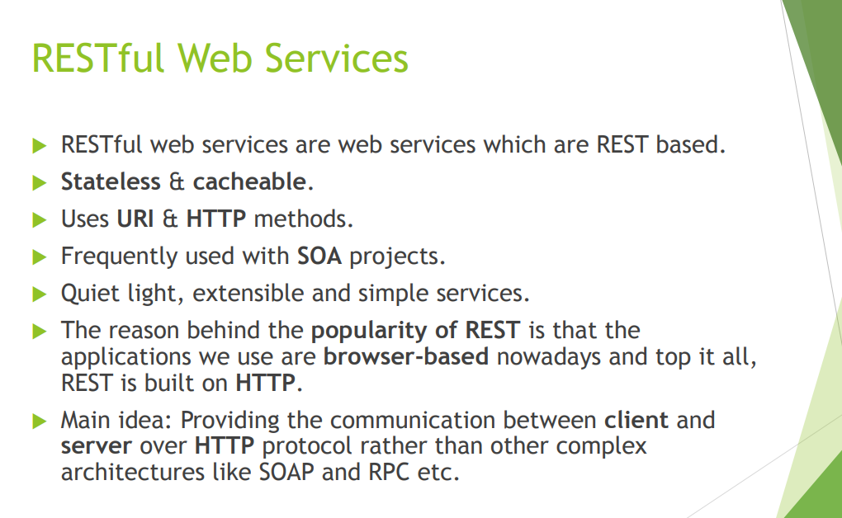

Slide 15
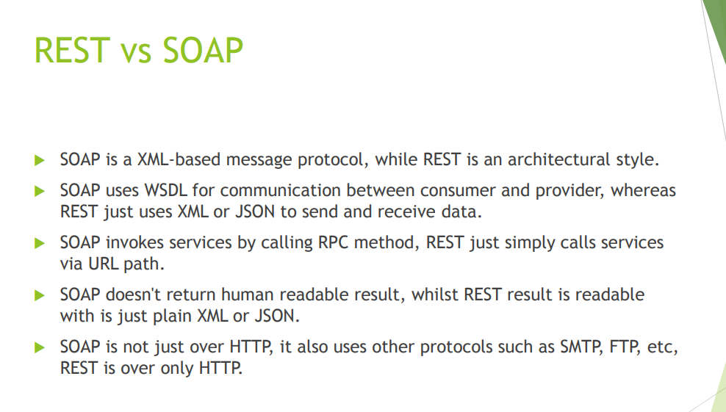

Slide 16
Building and Managing Java Projects with Maven

Slide 17
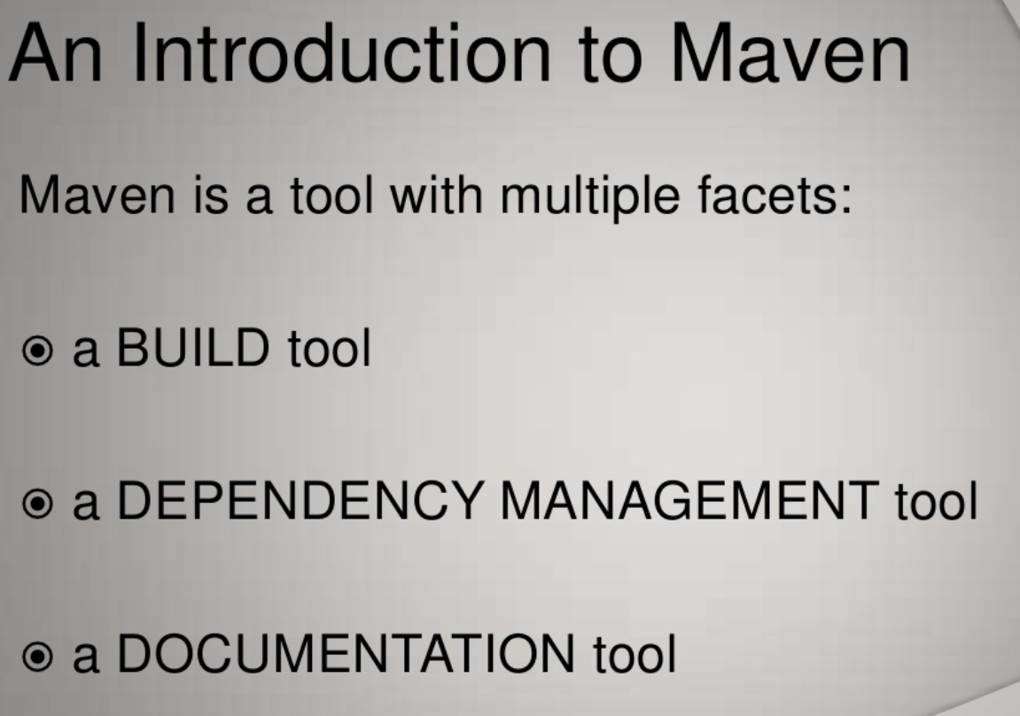

Slide 18
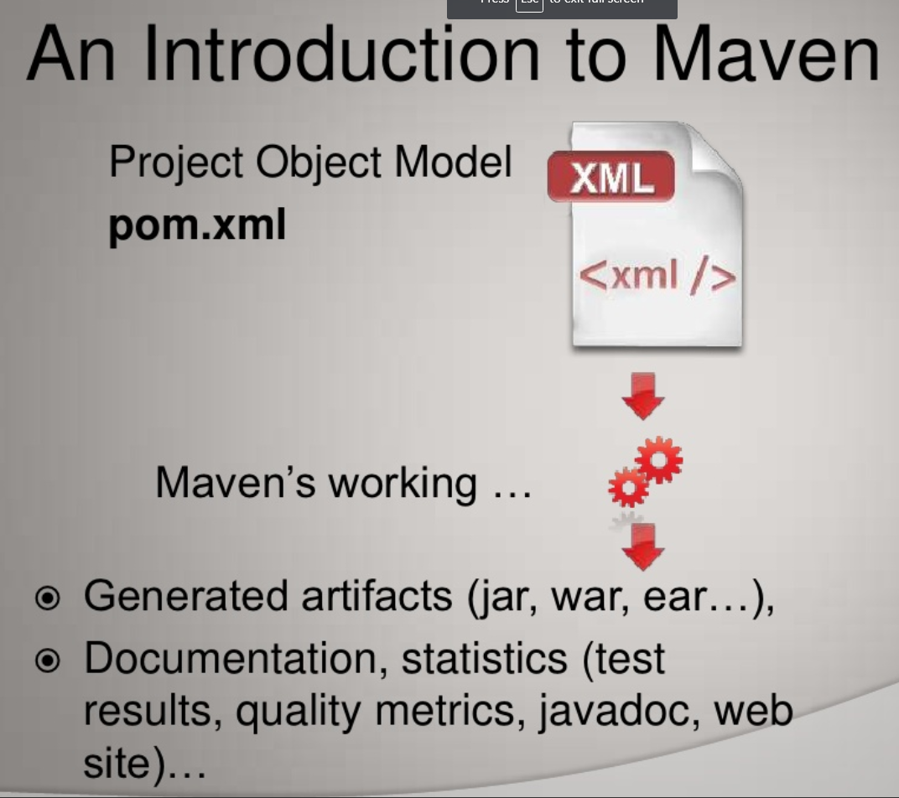

Slide 19
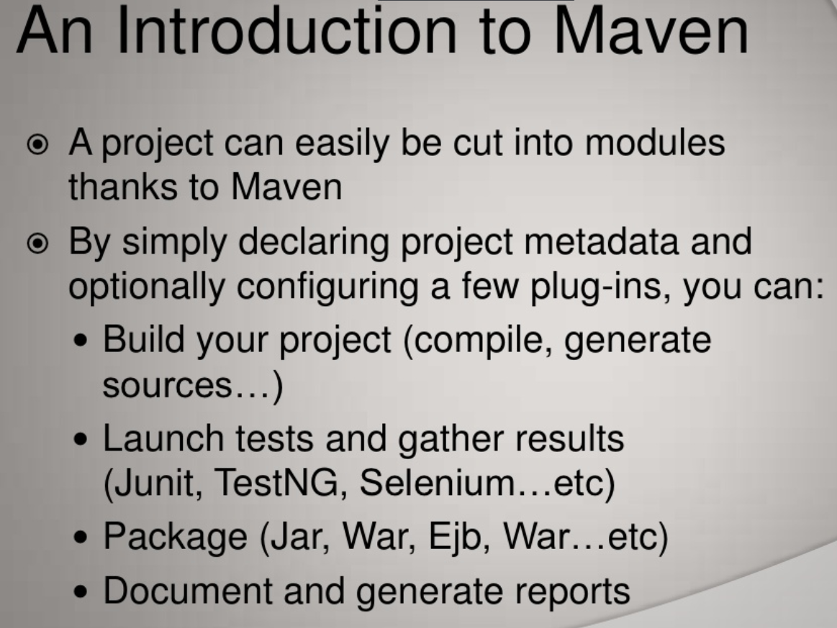

Slide 20
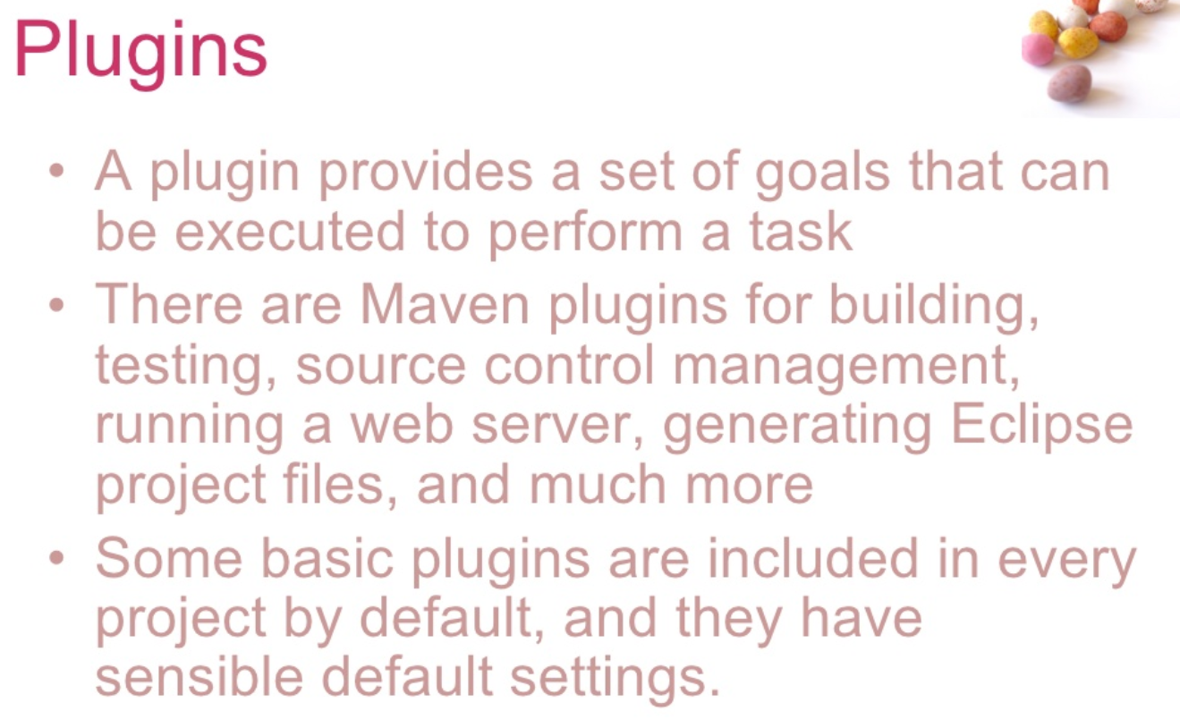

Slide 21
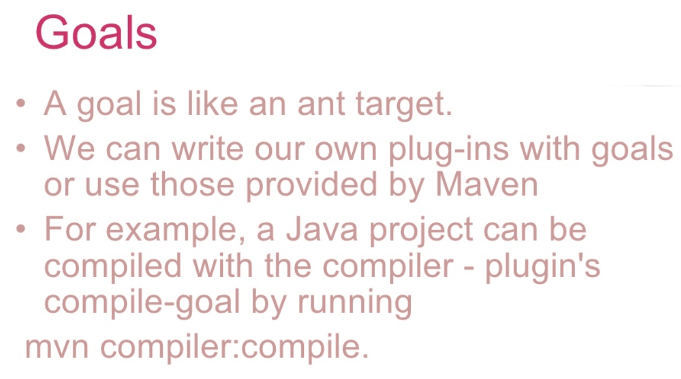
mvn spring-boot:run

Slide 22
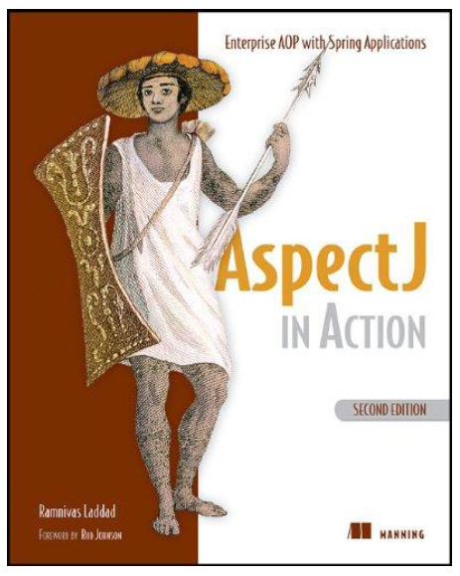

1-Aspect Oriented Programming
2-Spring Boot Programming

Slide 23
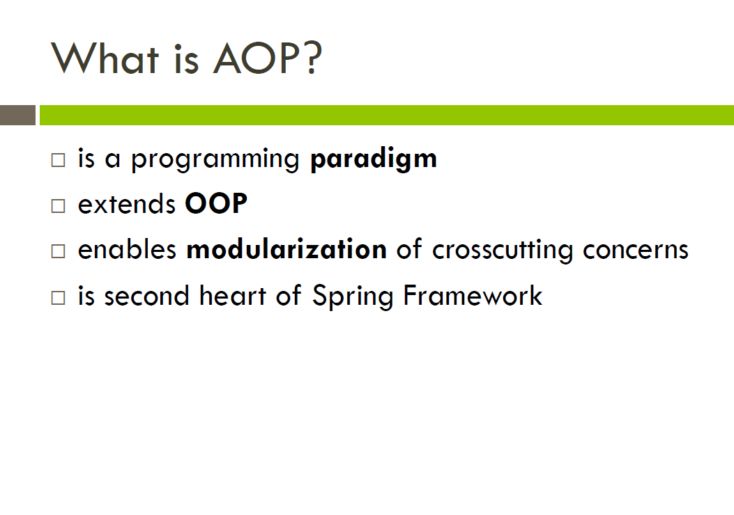

Slide 24
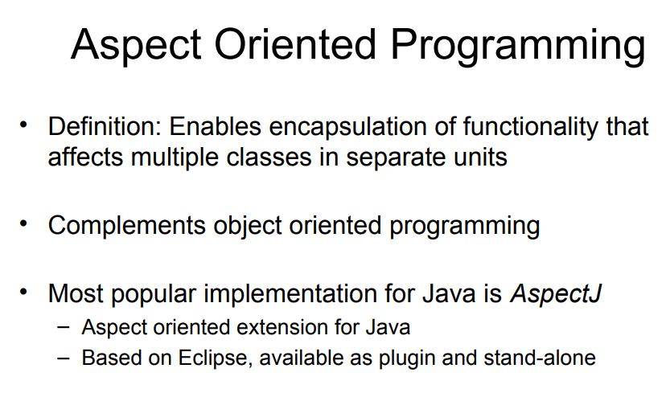

Slide 25
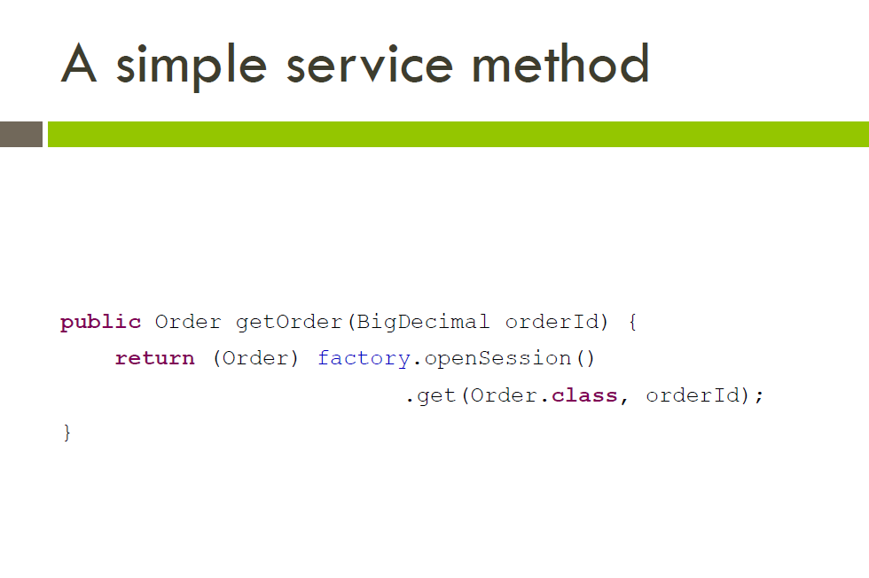

Slide 26
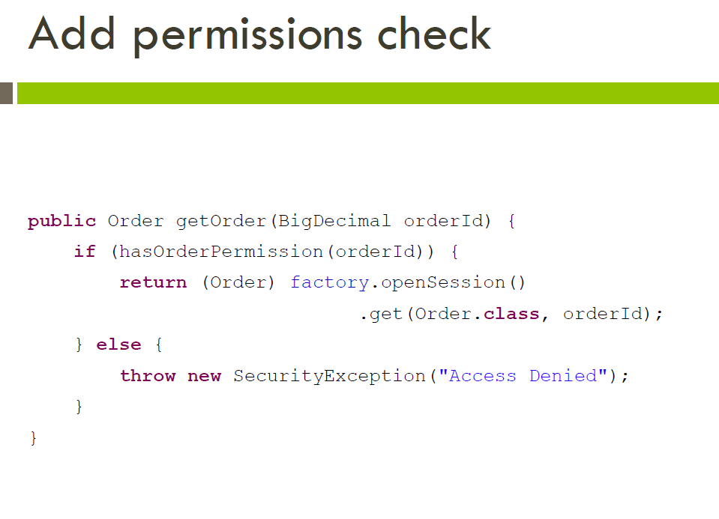

Slide 27
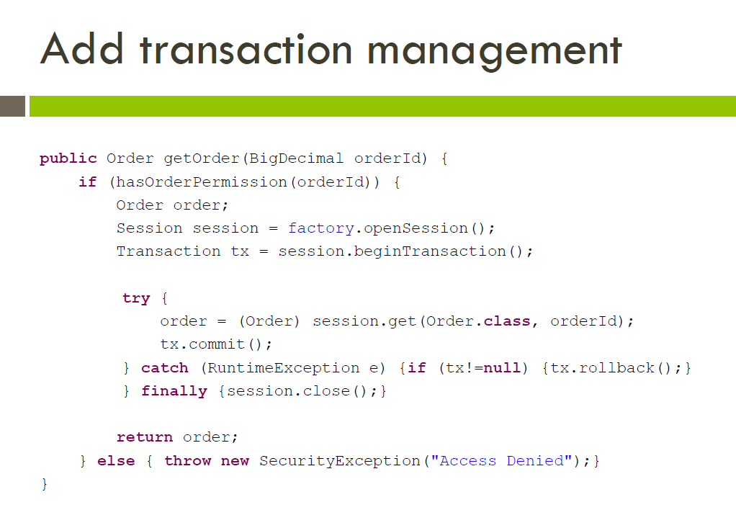

Slide 28
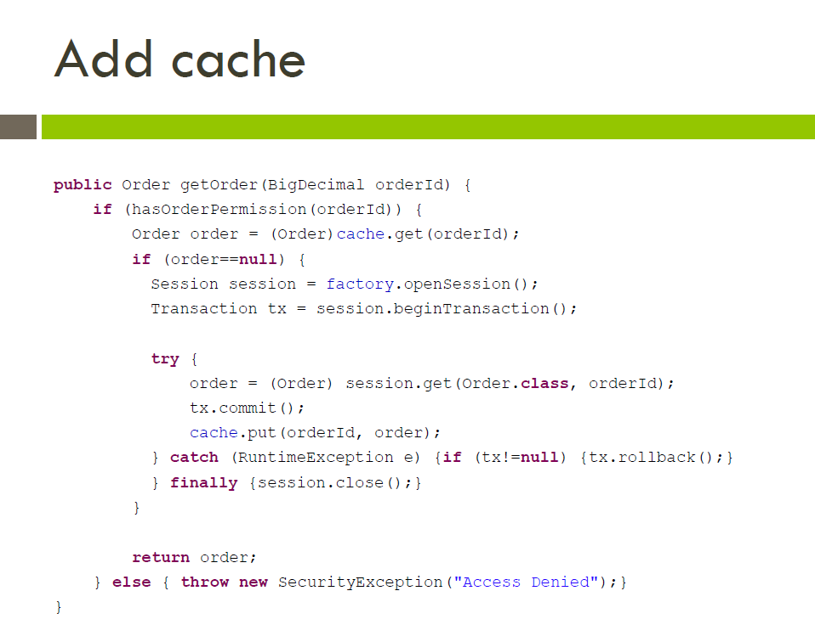

Slide 29
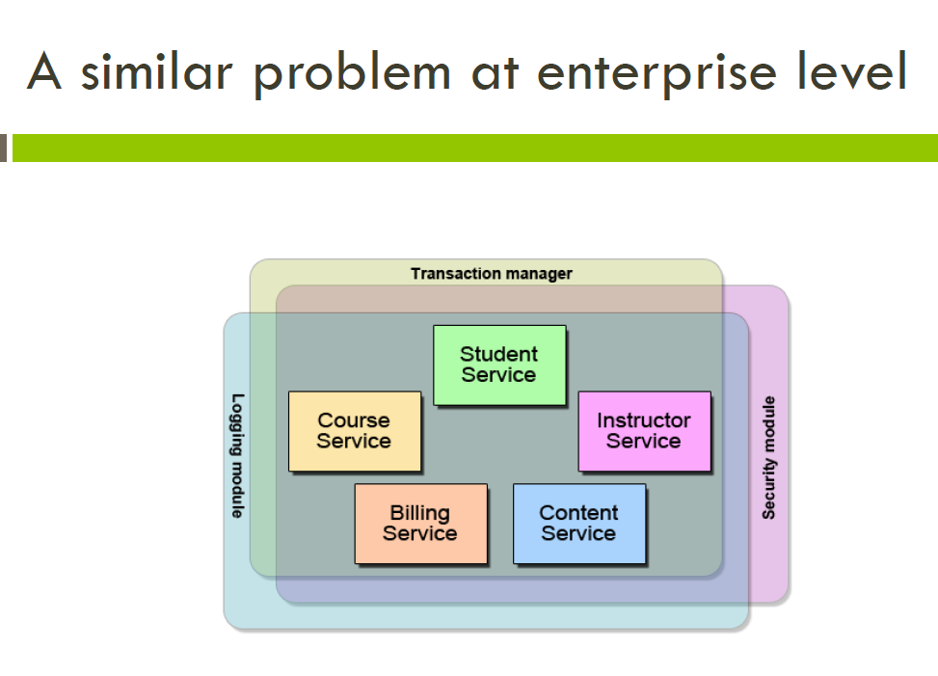

Slide 30
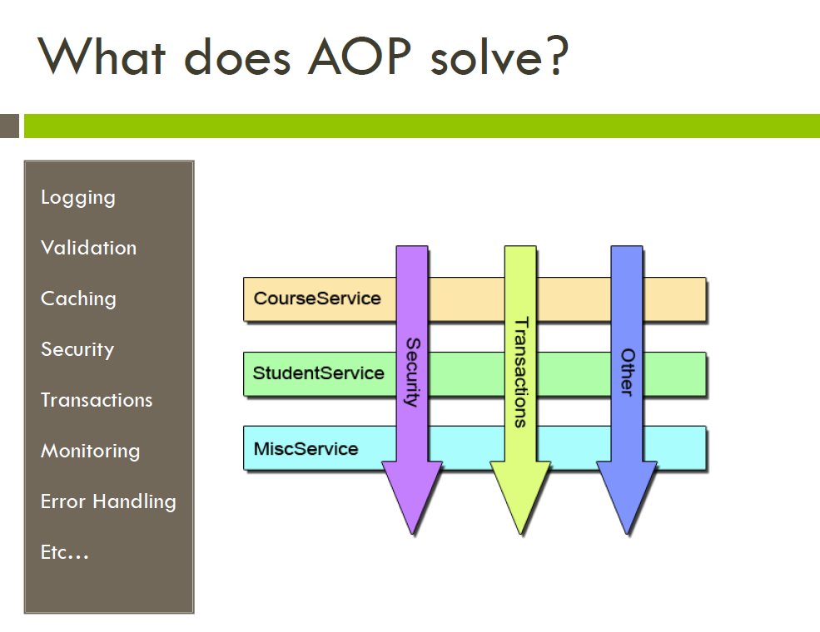

Slide 31
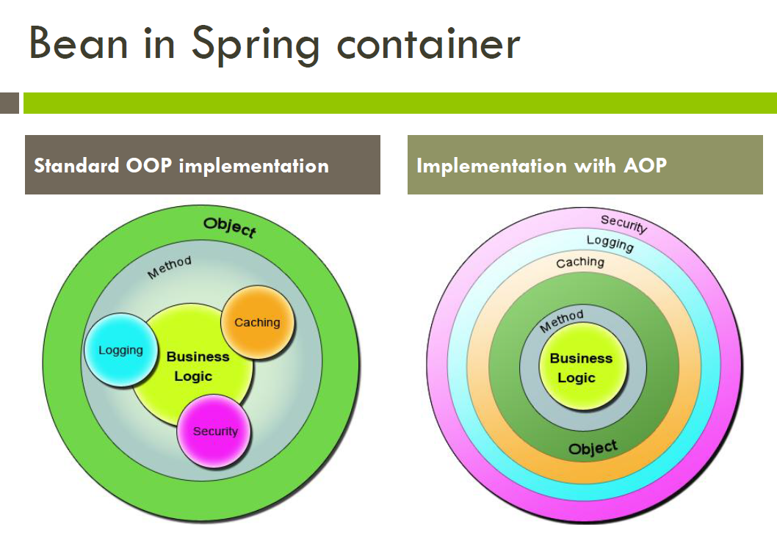

Slide 32
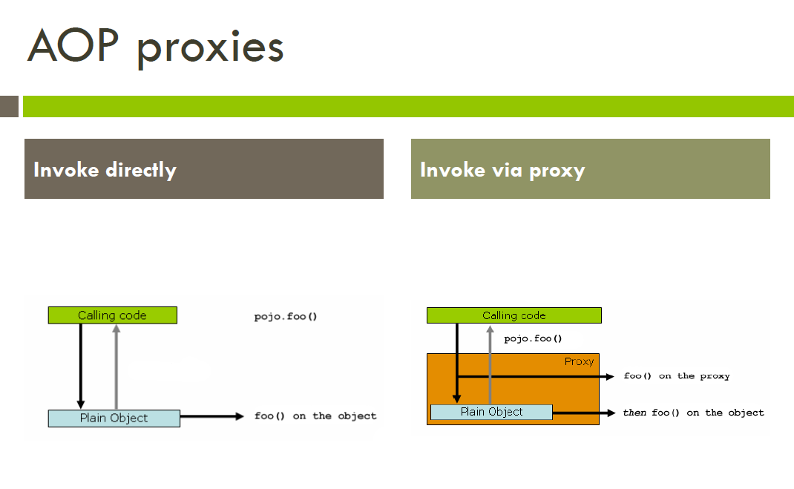

Slide 33
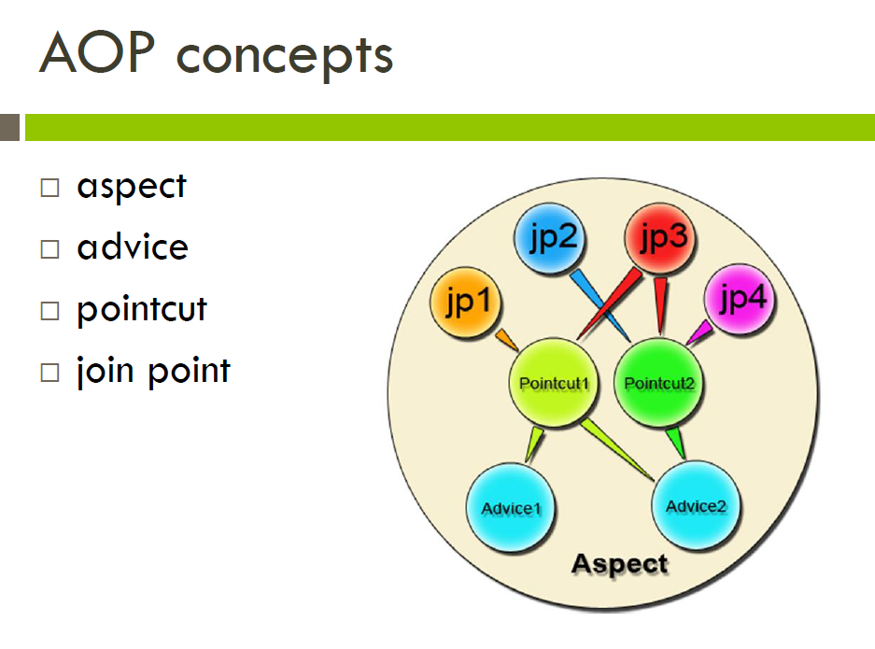

Slide 34
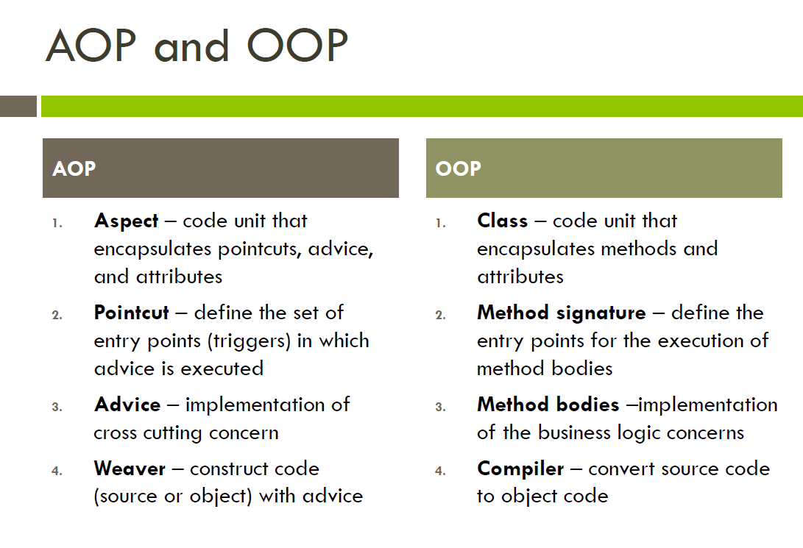

Slide 35
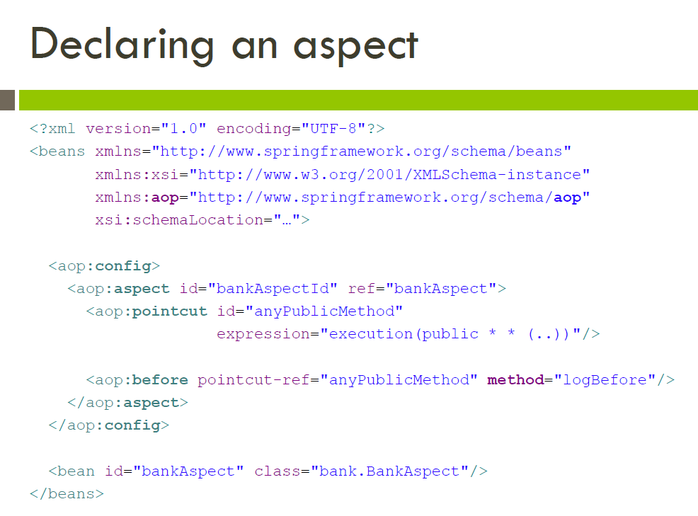

Slide 36
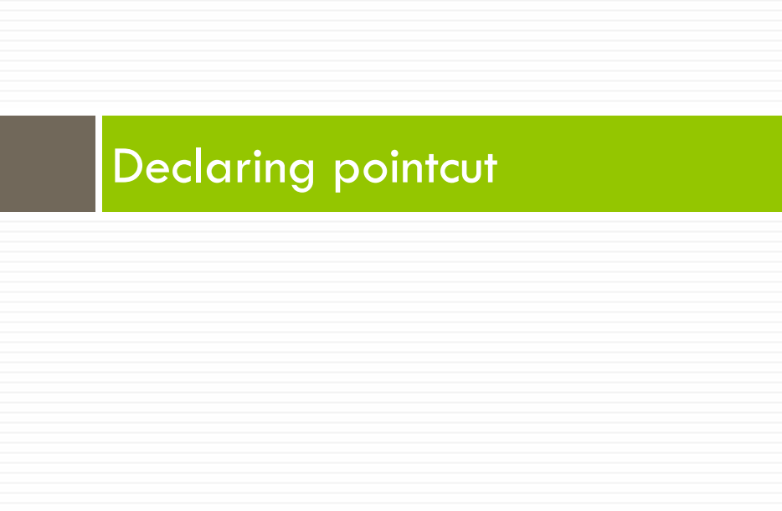

Slide 37
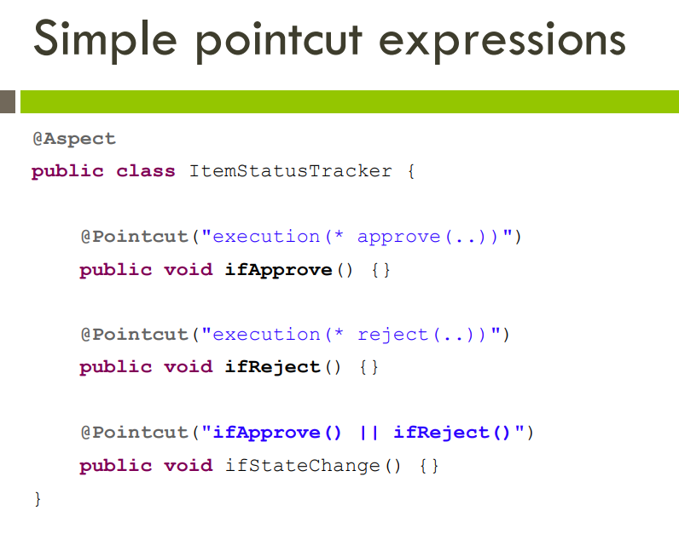

Slide 38
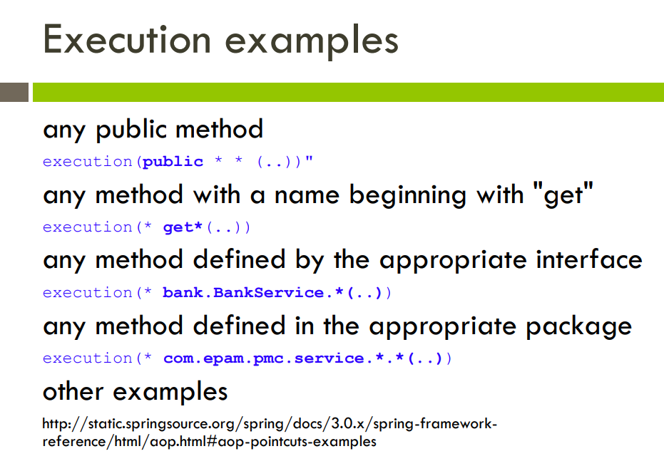

Slide 39
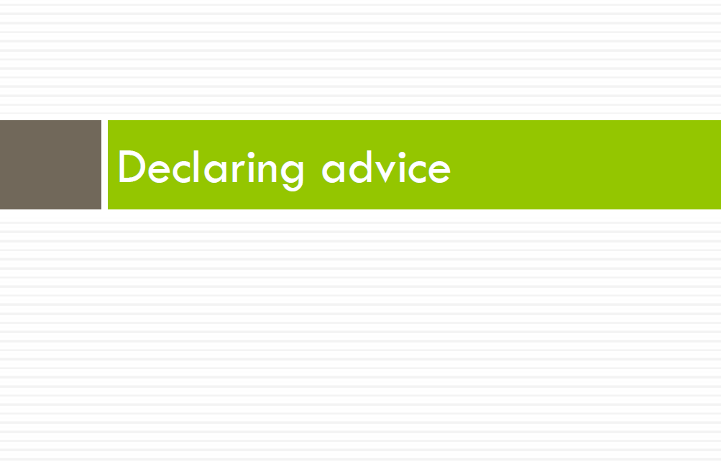

Slide 40
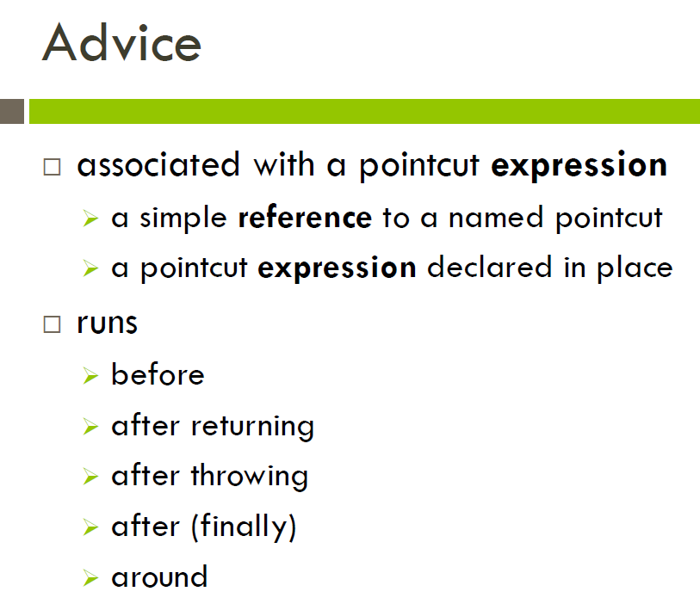

Slide 41
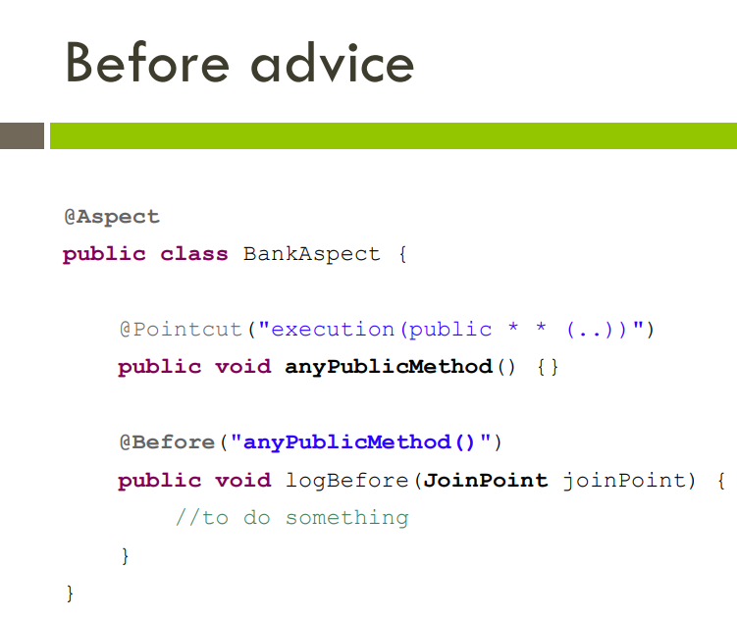

Slide 42
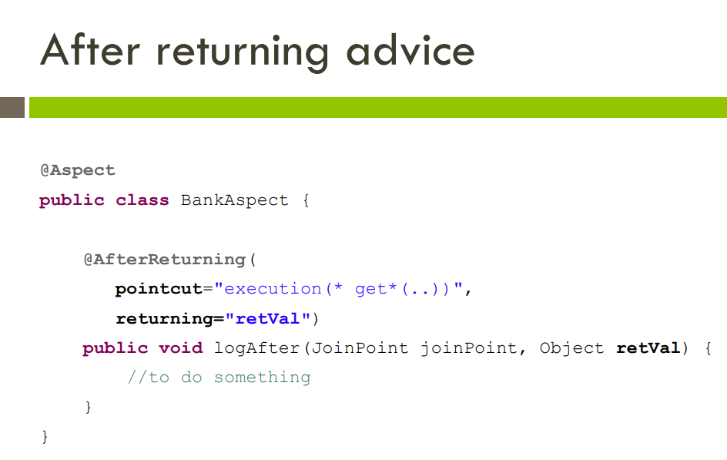

Slide 43
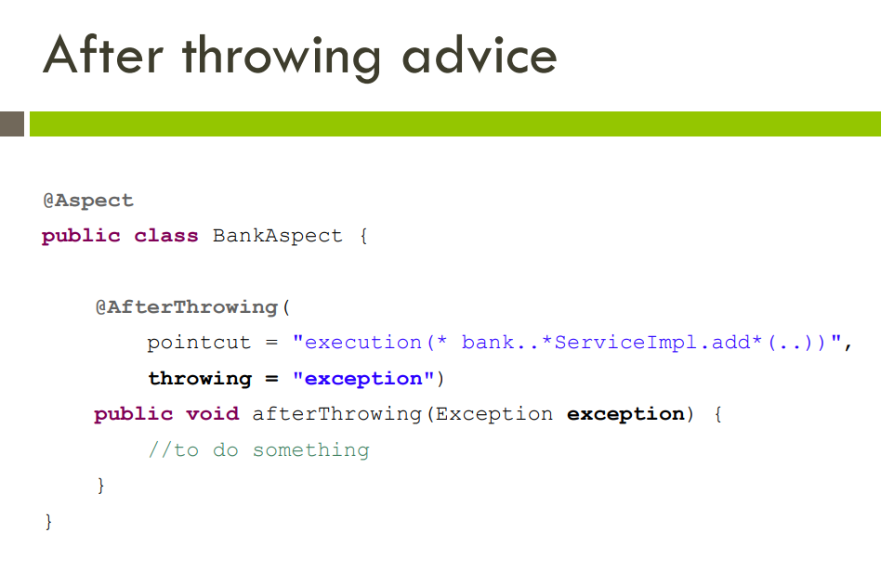

Slide 44
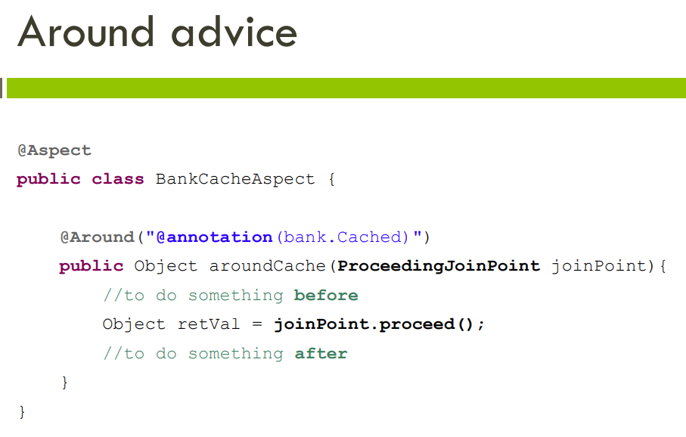

Slide 45
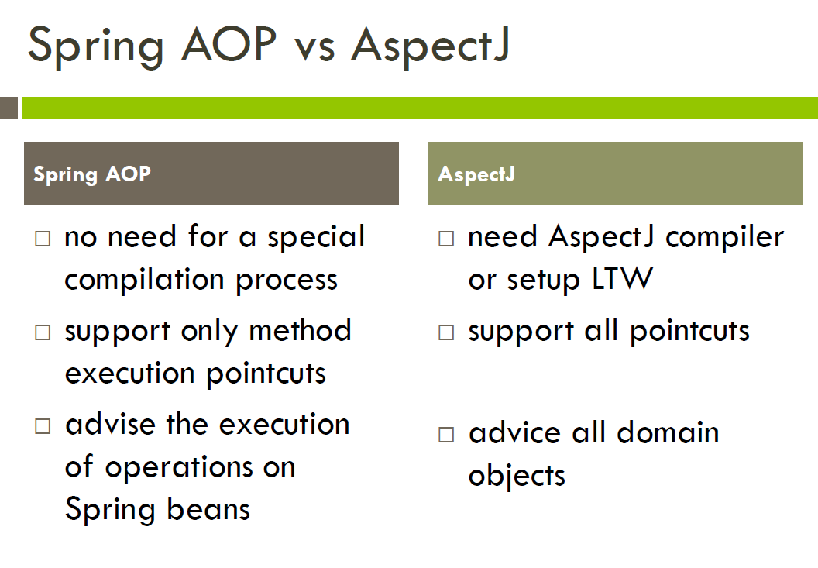

Slide 46
What is Spring?
“The Spring Framework is an open source application framework and inversion of control container for the Java platform.”
http://en.wikipedia.org/wiki/Spring_Framework
Inversion of control container is also called dependency injection
Supports many templating engines for web-service and also full-featured dynamic web-sites.
Support for popular Frameworks such as Bootstrap, Vaadin, Thymleaf, etc. etc. etc.

Slide 47
Inversion of control container / dependency injection:
Rather than instantiating an object using the new keyword, the container injects (and manages) a reference for you.
This may seem just a delegation swap, but it has important implications for the scope of those objects.
You have seem dependency injection in FXML already.
Inversion of control container is also called dependency injection

Slide 48
SpringBoot

Slide 49
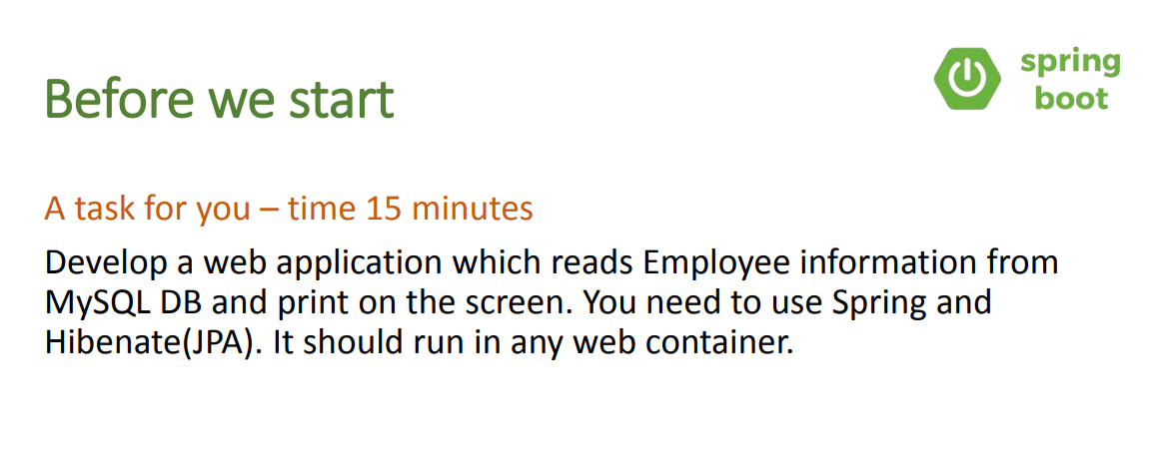

Slide 50
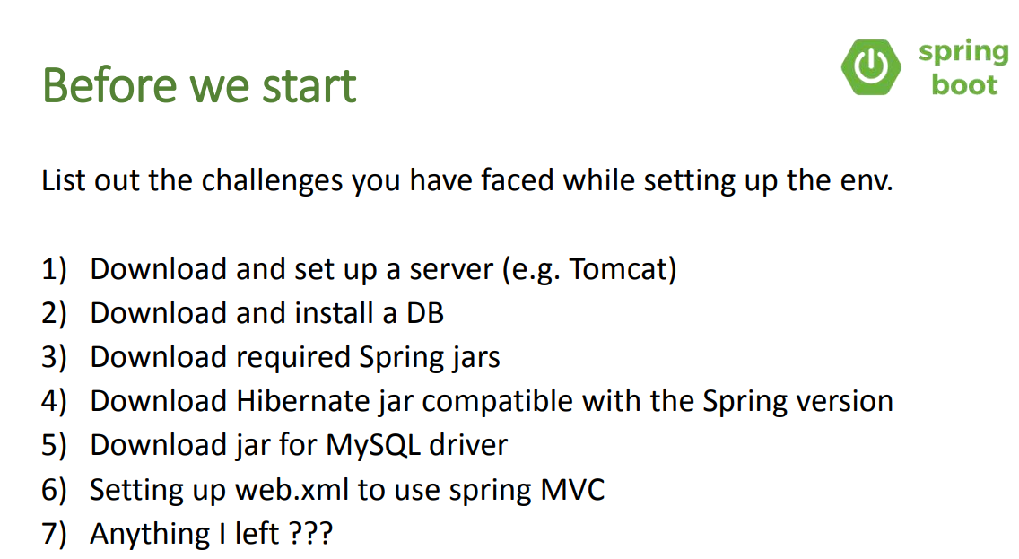

Slide 51
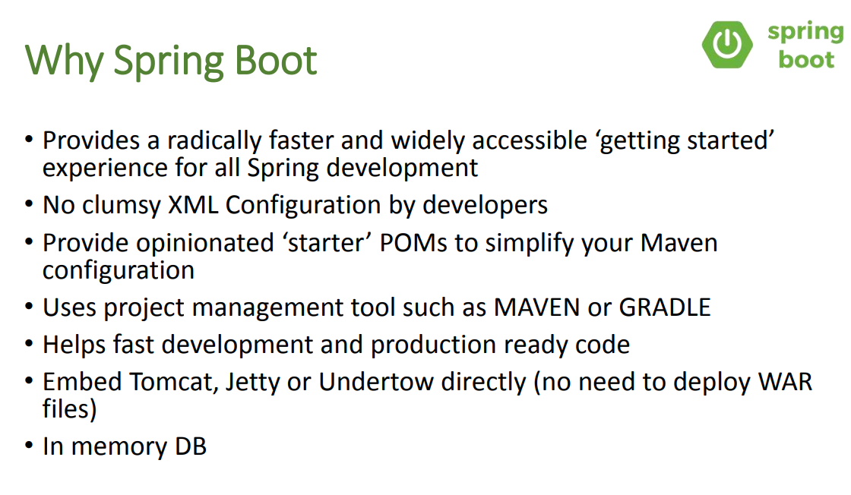

Slide 52
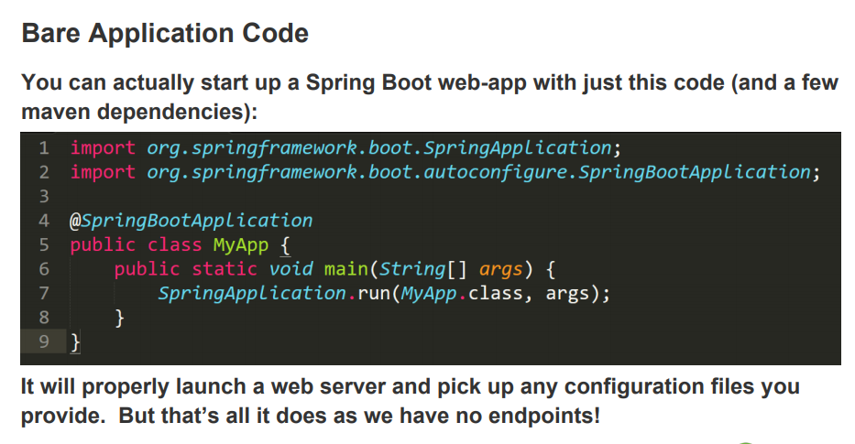

Slide 53
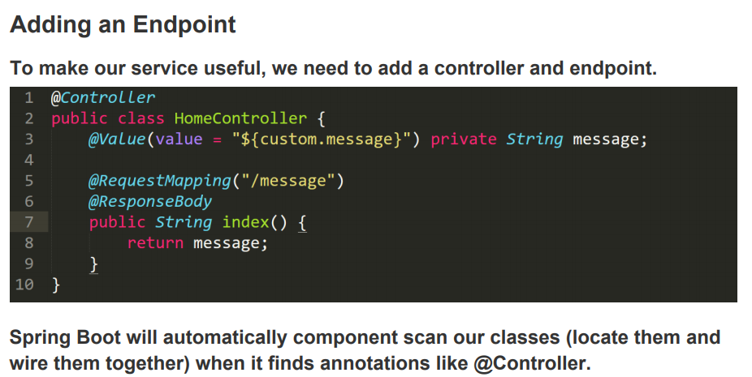

Slide 54
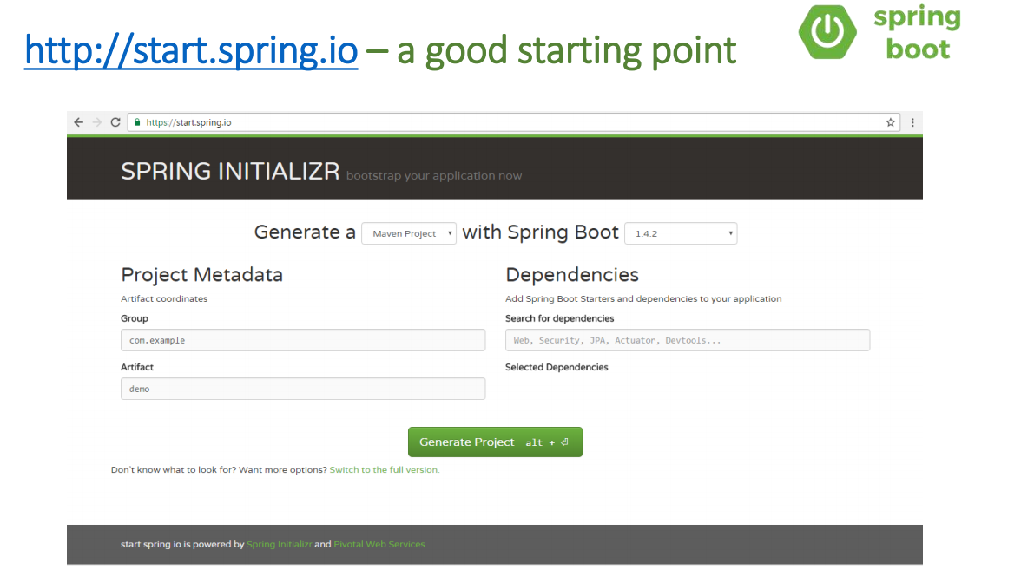

Slide 55
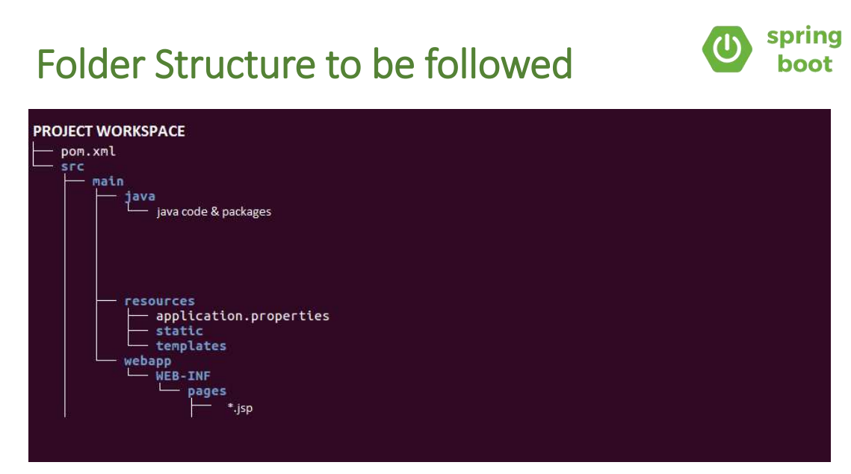

Slide 56
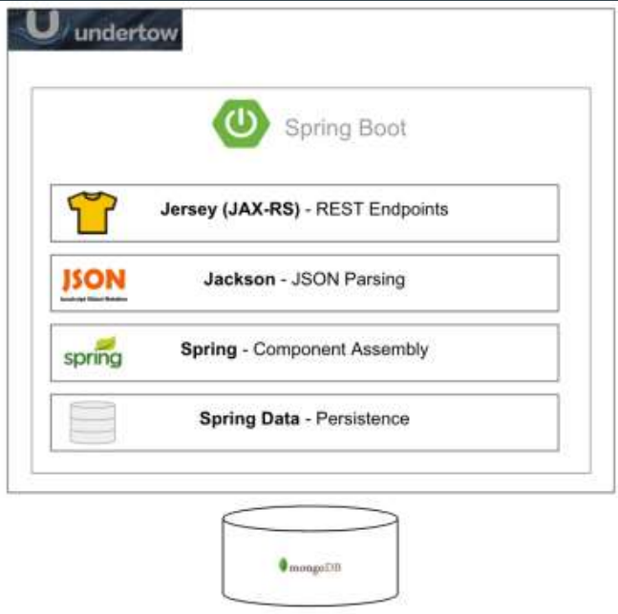
Spring Boot

Slide 57
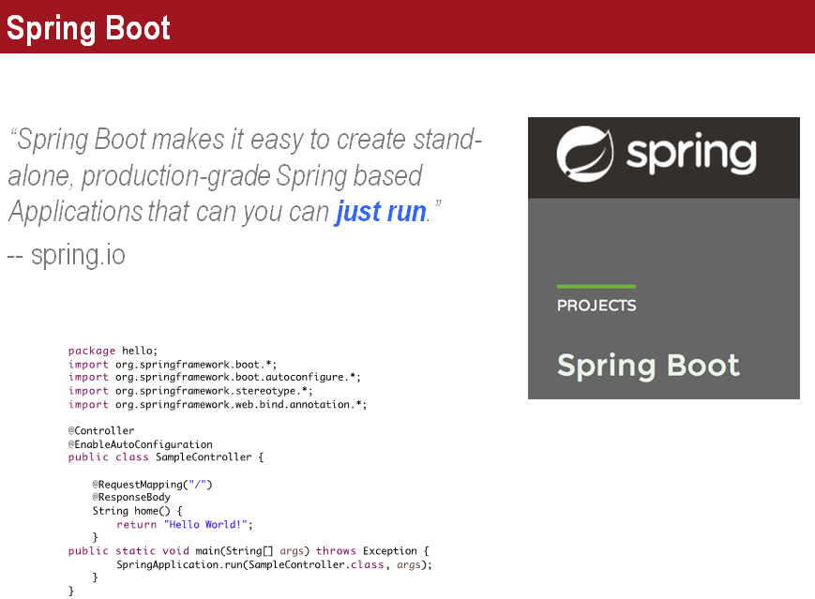

Slide 58
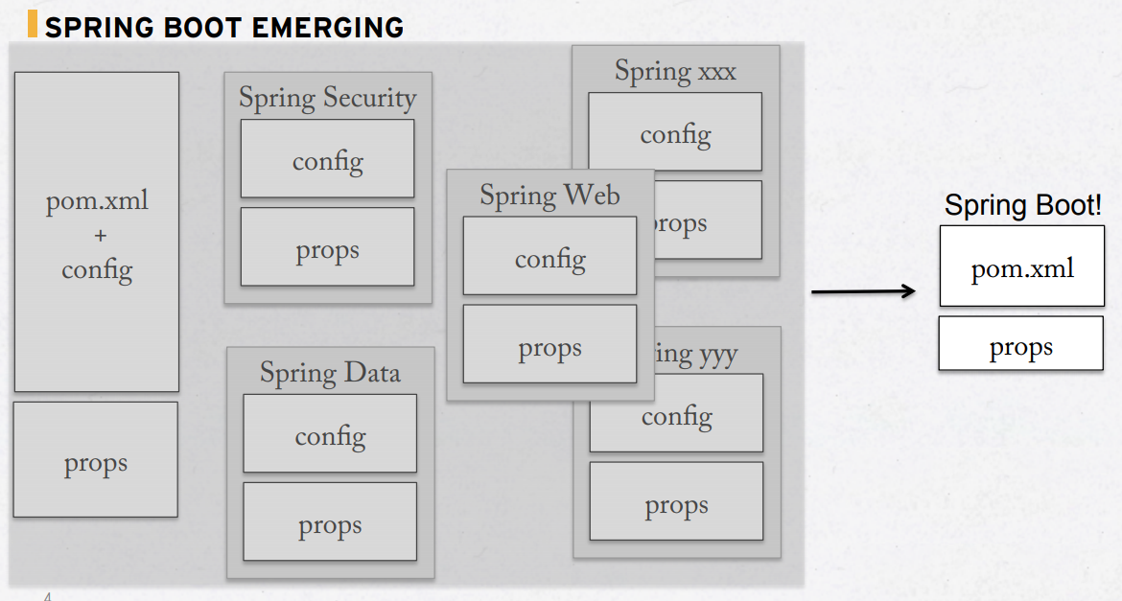

Slide 59
● Dramatically reduces boilerplate code
● Enables polyglot
● Simplifies integration testing
● Simplifies environment maintenance

Slide 60
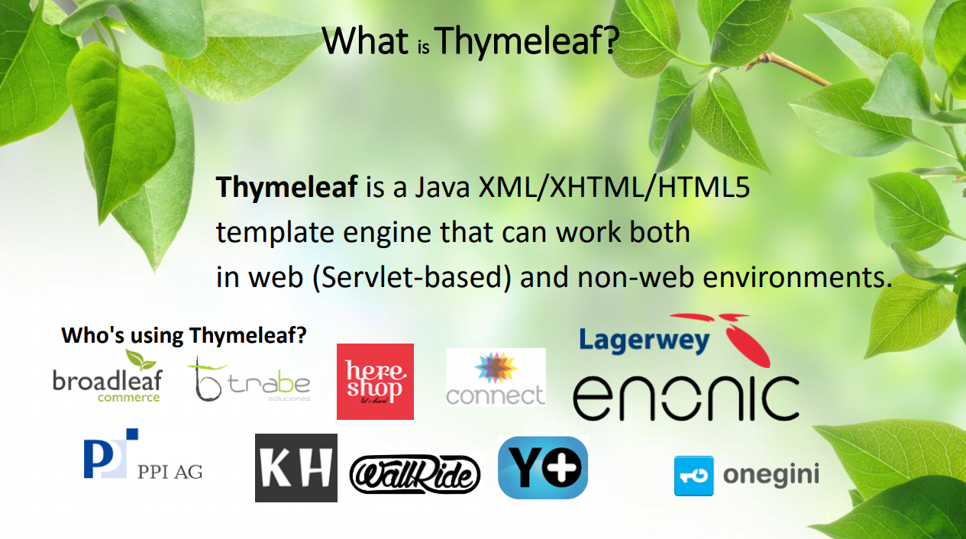

Slide 61
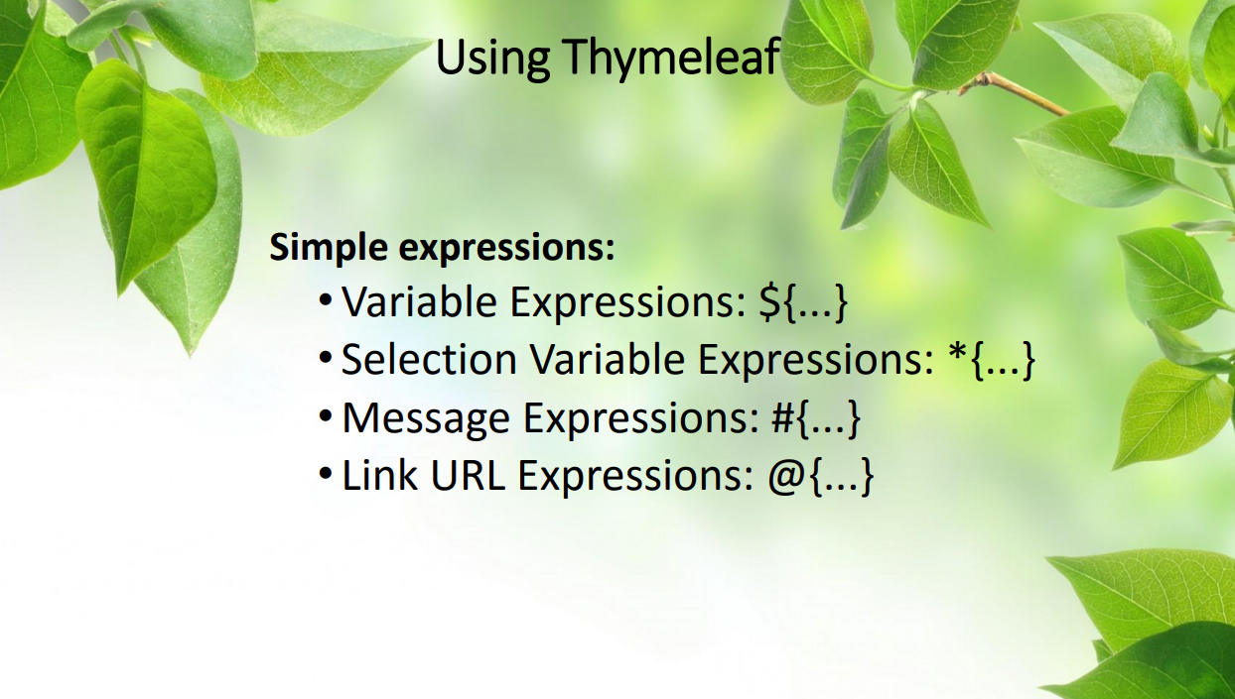

Slide 62
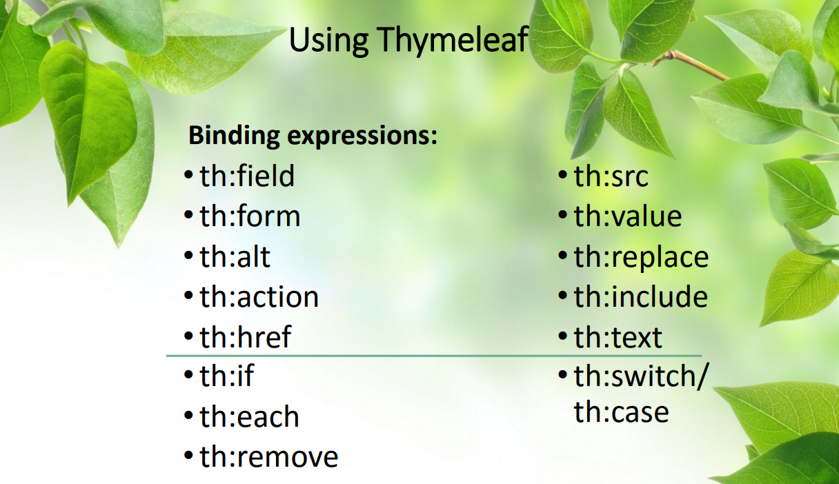

Slide 63
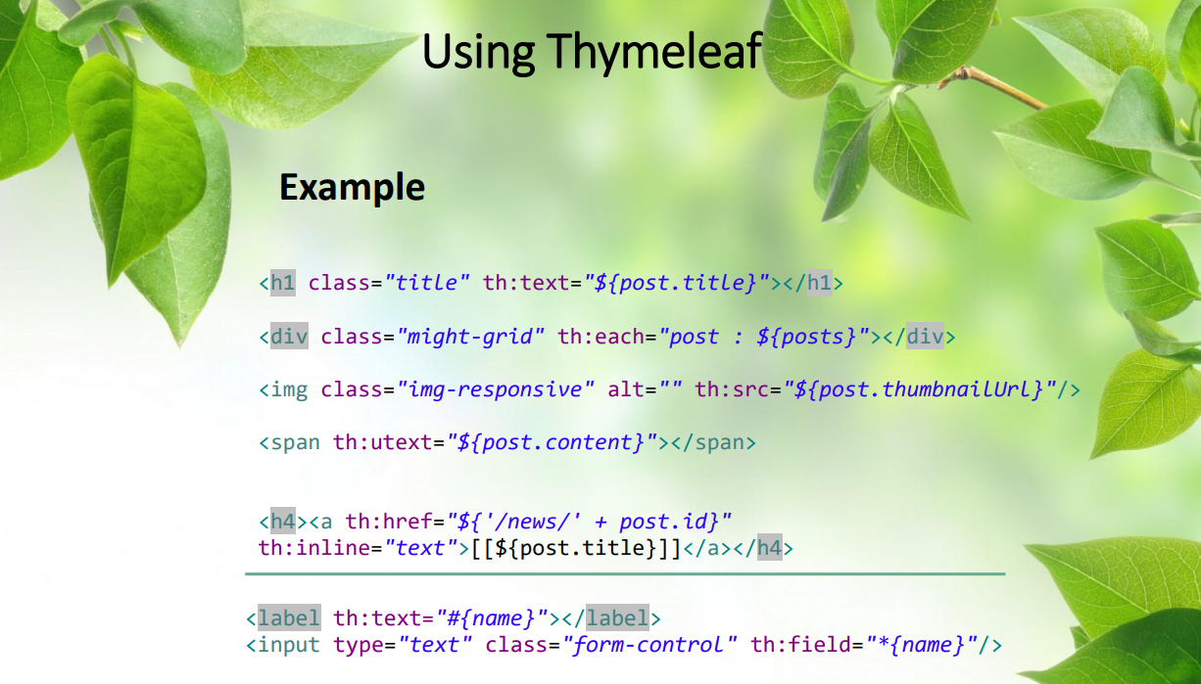

Slide 64
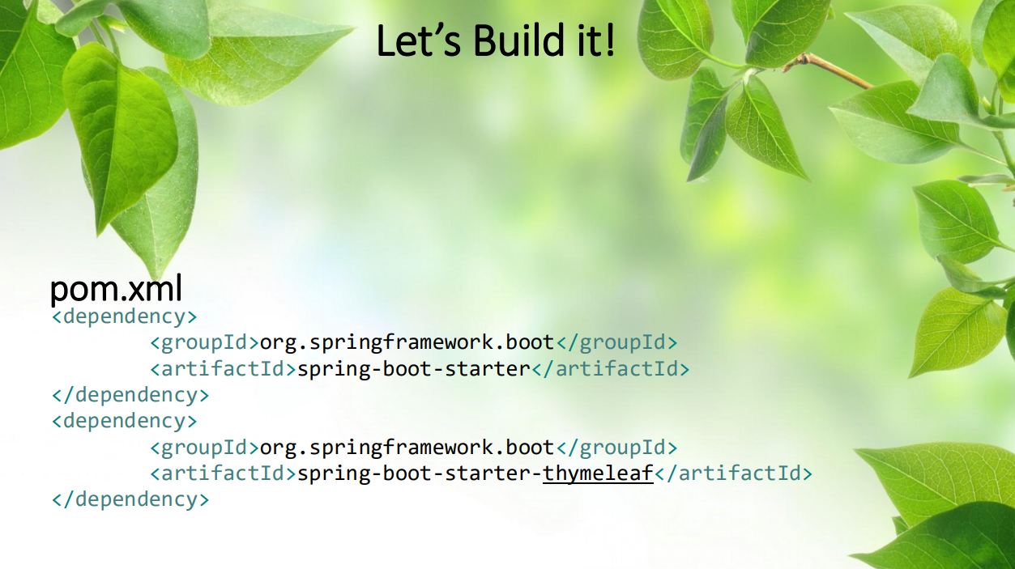

Slide 65


Slide 66


Slide 67


Slide 68
Let’s have some fun
1-Download Apache Maven Latest version
2-Make sure you install JDK 1.8 and defined in your System Path.
3- go to http://start.spring.io/ , configure your POM file
Open your maven project using (Eclipse , VSC , netbeans ,….)
Build the maven repo from CMD.
Develop hello world web service.

